Slide 1
VIRTUAL ASSISTANT
Submitted By:
Arun pandiyan M
20223112404120

Slide 2
Abstract
This project focuses on the creation of a virtual assistant using the Python programming language.
The virtual assistant will have features including speech recognition, text-to-speech conversion, context understanding, task automation, and integration with external services such as time, weather , and WebApplications.

Slide 3
Introduction
This Project is Determine what tasks you want your virtual assistant to perform. This could include things like answering questions, providing weather updates, show correct Time, Search something in Google, Opening Gmail, Opening YouTube ,Opening Wikipedia,etc..

Slide 4
Existing System
The System Uses Natural Language processing (NLP) techniques to understand and interpret user queries or commands.
Machine learning algorithms are employed to improve the system’s ability to recognize patterns, learn from user interactions.
Integrates with various APIs to perform task.

Slide 5
Drawbacks
Struggle to understanding complex queries, slang ,or non standard language patterns.
When System has poor internet connection then Not Working properly

Slide 6
Proposed System
Implement Advanced NPL techniques to understand complex queries.
Our Project will be work in both online and offline mode(with Some limitation).
There will be no database server, we only storing data in the local storage and then processing.
This project will also support customized command and result
So we can also add our own command and their results

Slide 7
Advantages
Saving user time and effort by quickly providing information.
It can be accessed from various devices and platforms.
It can personalize interactions based on user preferences.
24/7 availability

Slide 8
Hardware requirements
Processor : AMD PRO A4-4350B R4, 5 COMPUTE CORES 2C+3G 2.50GHz
RAM : 4 GB
Hard disk : 512GB
CPU Model : AMD PRO A4-4350B R4, 5
Screen Size : 15.6 inches

Slide 9
Software requirements
Operating System : Windows 10
Front End : tkinter
Back End : Python
Simulation Tools : Visual Studio Code
Python : Latest Version
Packages : pillow, lxml, requests-html, pyttsx3
SpeechRecognition, PyAudio

Slide 10
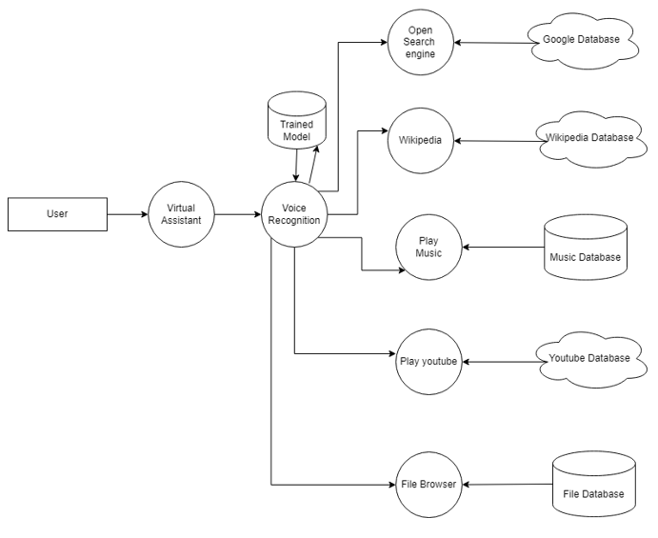
Architecture

Slide 11
Modules
Pyttsx3
Speech recognition
Pyaudio
Pyowm
webbrowser

Slide 12
Pyttsx3 (Python Text to Speech)
A python library that will help us to convert text to speech.
Speech recognition
Speech recognition is the process of converting spoken words to text.
Pyaudio
it can be used for access your microphone with Speech Recognizer.
Pyowm(python open weatherMap)
it can be used for Access to weather data and forecast
Webbrowser:
It can be used for opening web pages or links

Slide 13
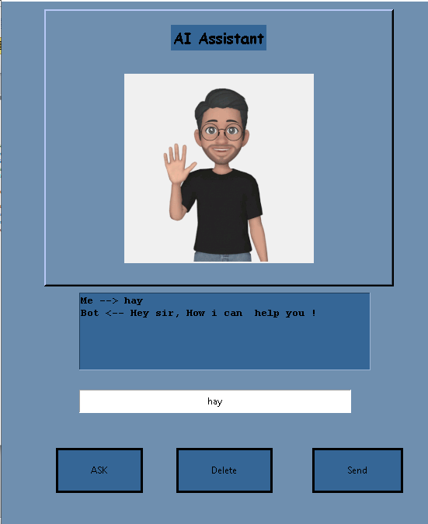
Output Screenshots:

Slide 14

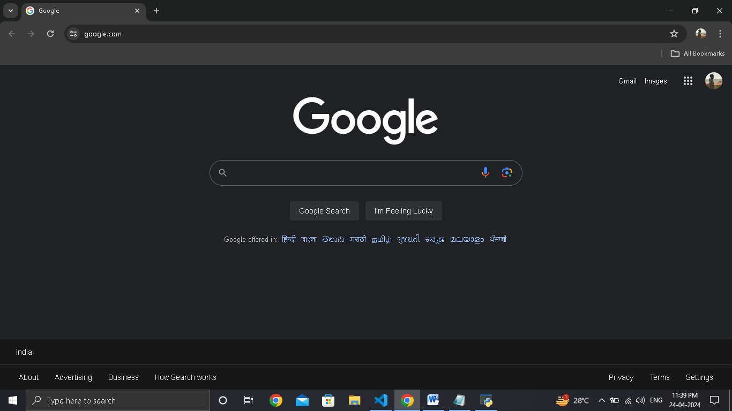

Slide 15
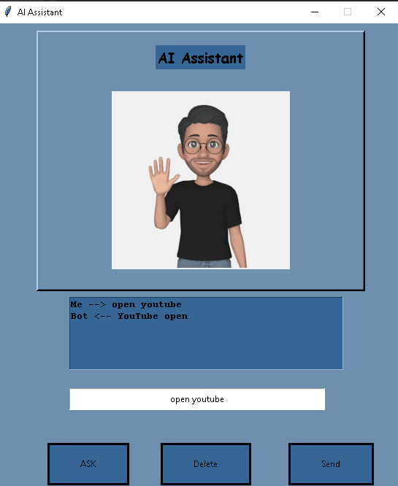
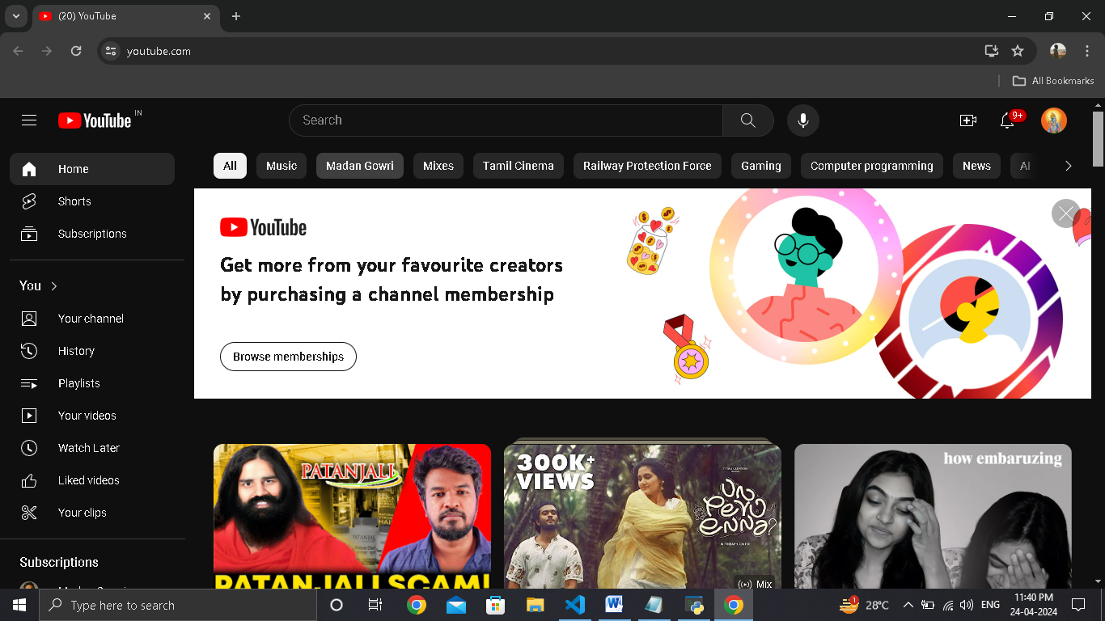

Slide 16
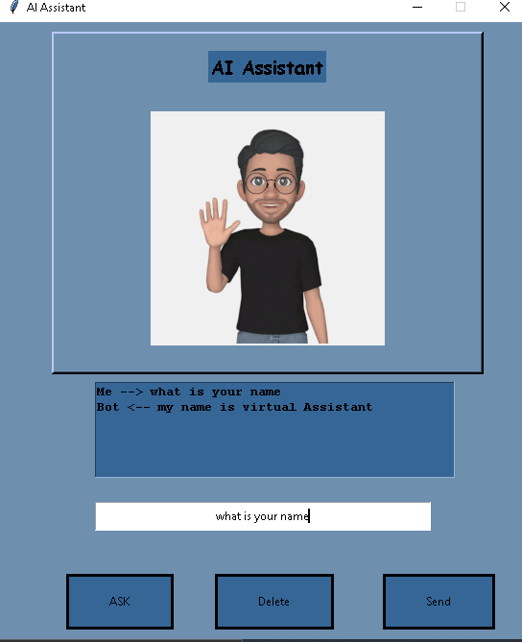

Slide 17
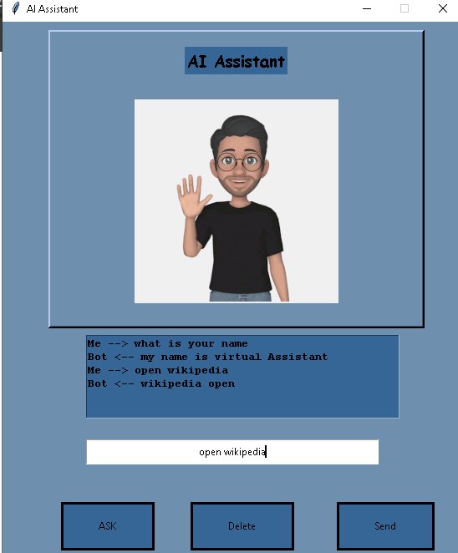
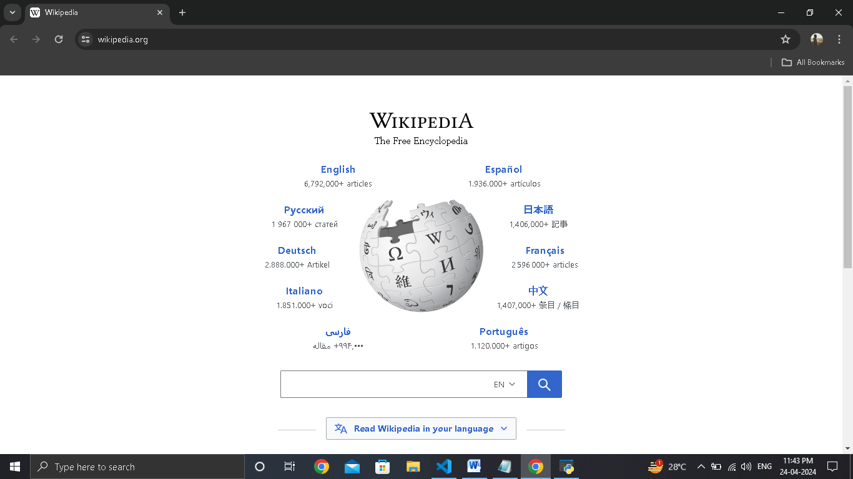

Slide 18
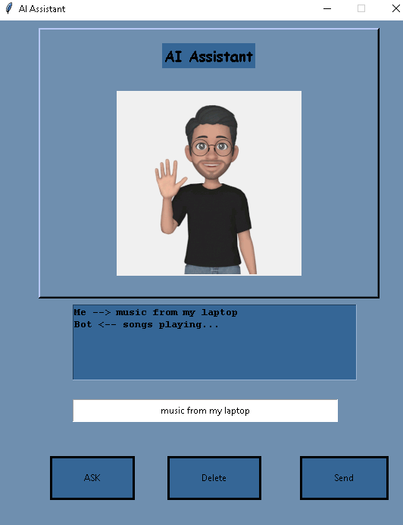
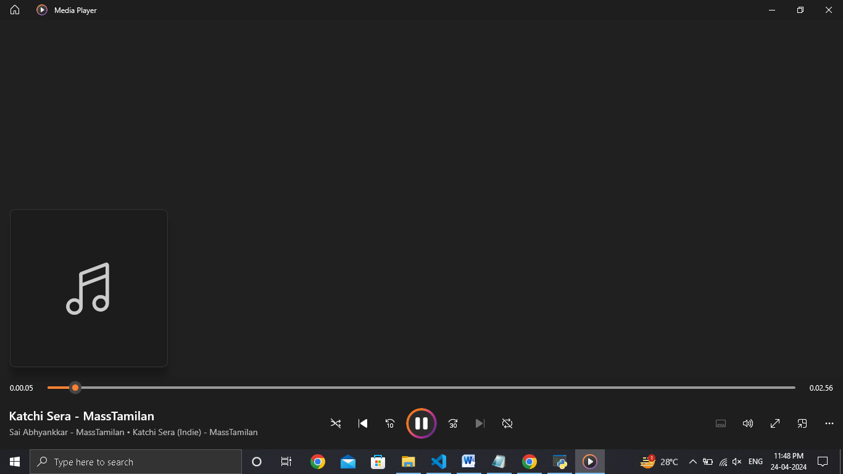

Slide 19
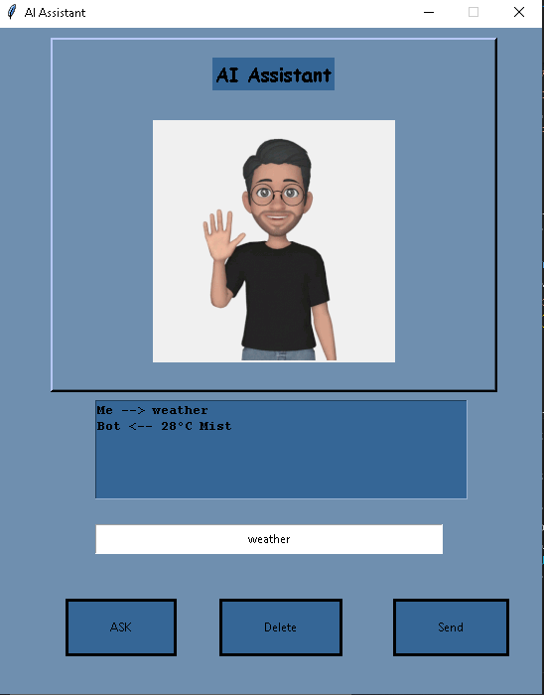

Slide 20
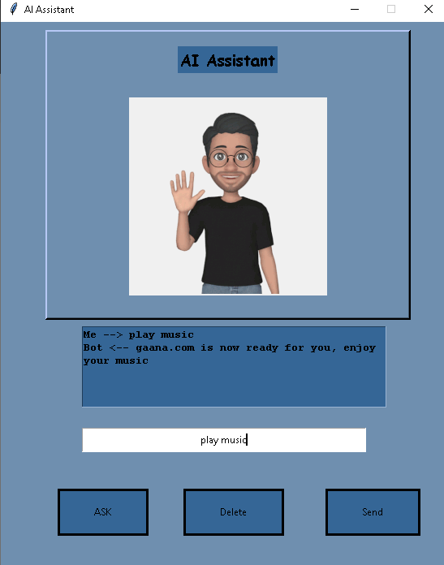
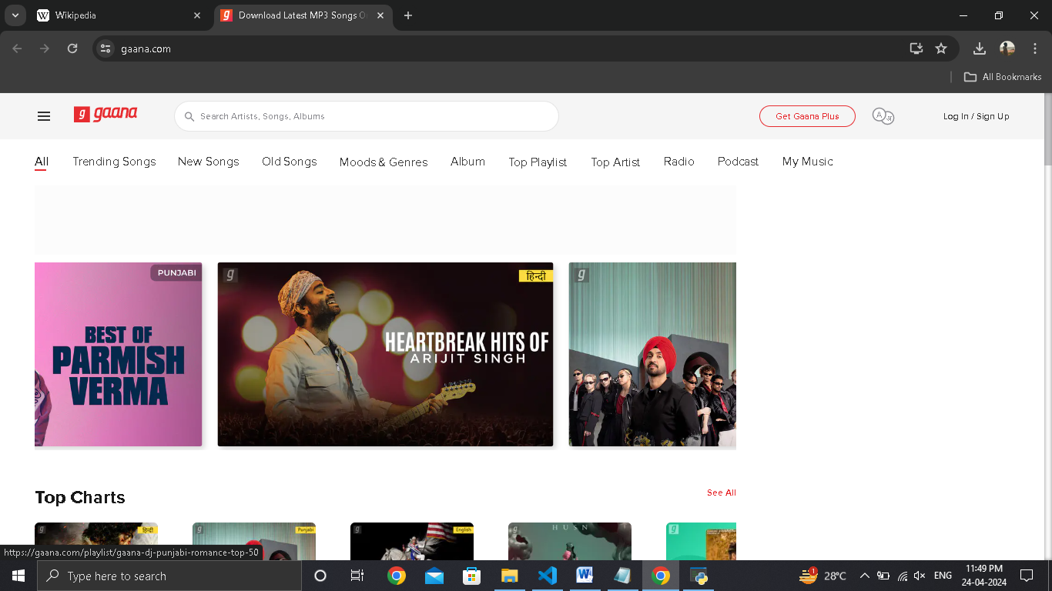

Slide 21
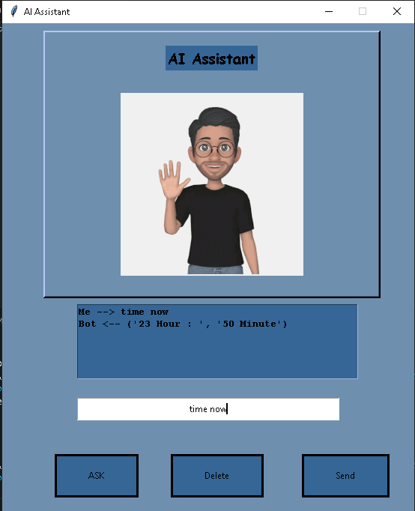

Slide 22
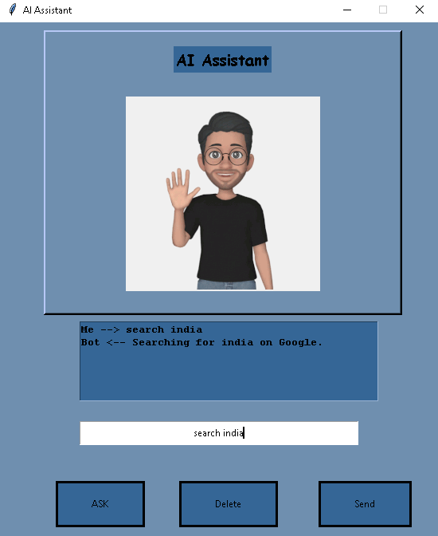
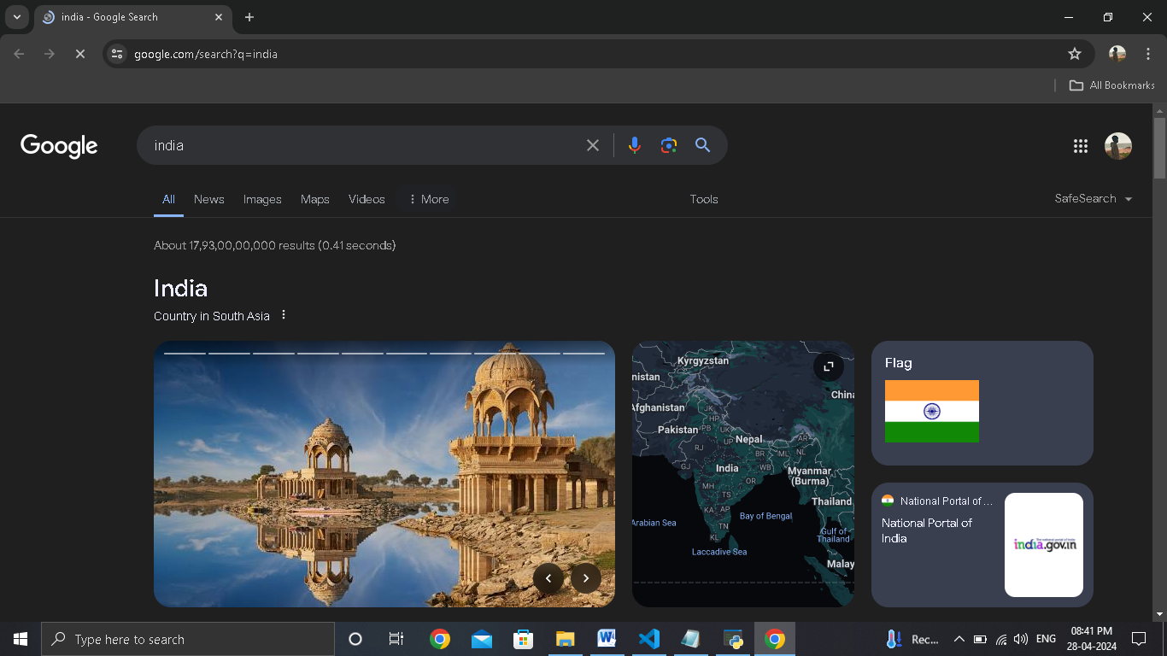

Slide 23
Conclusion
The primary goal of the virtual assistant project is run successfully
virtual assistant have transformed the way we interact with technology, offering unparalleled convenience and efficiency.
virtual assistants are likely to become even more integrated into various aspects of our lives.

Slide 24
Future Enhancement
In future I will developed android app for Virtual assistant.
Integrate emotional intelligence capabilities into the virtual assistant to recognize and respond appropriately to user emotions.

Slide 25
Thank You

